Slide 1
Multilanguage Sentiment Prediction
Smit Mehta (110024138)
Tilak Patel (105213945)
Hetal Mangukia (110023920)
Nencyben Patel (105170037)
Guided By:- Kalyani Selvarajah

Slide 2
Content
Introduction
Existing related work
Techniques related to advanced database
Work flow
Demo

Slide 3
Introduction
Sentiment analysis has several applications which can be used to know customer satisfaction.
Multilingual sentiment analysis gives a broader view as data of more than one language can be stored and used for sentimental analysis.
We have used Hindi-English dataset for the purpose of analysis.

Slide 4
Introduction
The reason for that is, in a particular sentence, people might use one or two words of language other than English.
Our model supports mix code settings, that is mixture of two or more languages.

Slide 5
Existing related work
The models which have been previously been followed are the ones using Natural Language Processing tools.
Recursive Neural Tensor Network involves generation of parse trees; these trees are not available for code mixed text, which in this case, is necessary.
Another approach is based on Word Embedding: They are Word2Vec and Word-RNN. These approaches were not able to provide reliable embedding in situations with small amount of highly sparse data.

Slide 6
Existing related work
Word2Vec is a group of similar related models that are used to produce word embedding.
Surface Feature Engineering based approaches have also been used; that is, hash tags, mentions by users and emoticons might not be present in the data.

Slide 7
Work flow
Our project relies on two major things: Dataset and Algorithm. We have collected a mixed language dataset from YouTube which can be used for performing sentiment analysis.
The collected dataset is converted into a document oriented dataset which will help in data pre-processing.
Data pre-processing will be performed on the data for converting the multi-language words into sub words and dividing in to smallest possible form of the words.

Slide 8
Work flow
The derived dataset would be more efficient, as least amount of words will be discarded due to mixed language support and a sentiment analysis would be possible on the dataset. Unwanted meaningless words will still be removed from the dataset.
As the dataset is ready it will proceed for training and testing purpose.

Slide 9
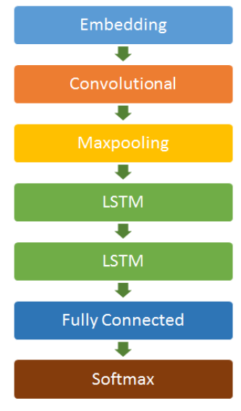
Architecture

Slide 10
Techniques related to advanced database
We have implemented the model using document oriented database program, that is MongoDB.
We can add structured or unstructured information in the same document.
Moreover, the data which we used for analysis is comments retrieved from various medias.
To store text based sentences, document oriented database like MongoDB is most reliable as operations like retrieval gets way easier.
There are a lot of connectors available to connect MongoDB and Python which makes our work a lot more easier.

Slide 11
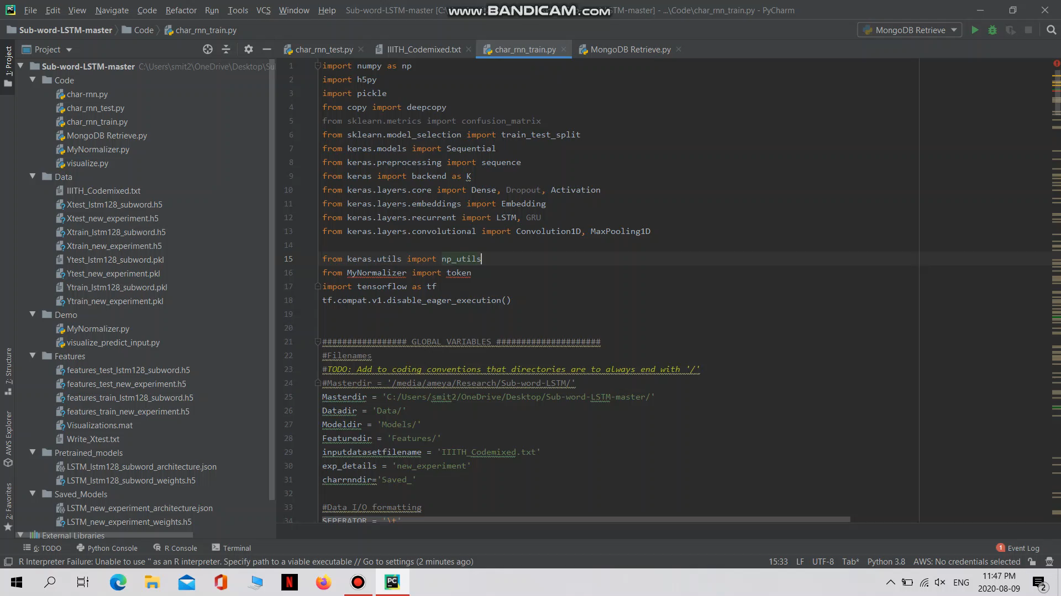
Demo

Slide 12
Thank you ! Any questions ?

